Slide 1
Online Retail Customer and Sales Analysis
Bryan Mahony

Slide 2
Problem Statement
A UK-based online retailer known for unique, all-occasion giftware is looking to increase its customer retention and develop more targeted product strategies.
They shared 18 months of sales data from which they were looking to identify:
Unique customer profiles and potential revenue generating strategies for each
Patterns in sales for specific products
Any other insights which could boost sales and revenue generation

Slide 3
Executive Summary
RFM analysis identifies three unique customer profiles; we can develop targeted strategies based on their behaviors
Sales analysis identifies 88 highest-grossing products across segments
Tableau visual analysis highlights key business trends with significant implications for OnlineCo

Slide 4
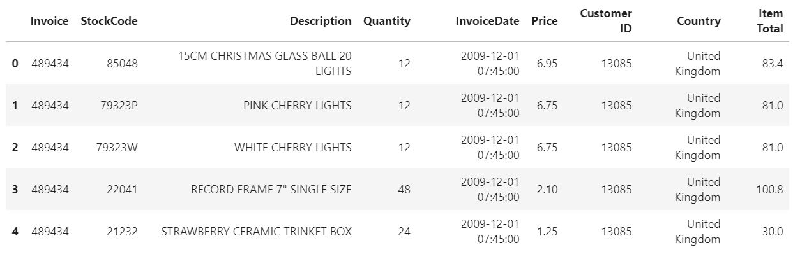
Data Source
Data shared by OnlineCo covers a time period of 18 months between 1/12/20 and 9/12/20.
525,460 rows, each representing a product purchased online, invoice number and a customer ID (where applicable).
Each row contains 9 features describing the product and its sale.

Slide 5
Analysis Overview – RFM approach
We used an RFM analysis (recency, frequency, monetary value) to segment customers. Three key dimensions:
Recency of purchase – how long has it been since the customer’s most recent transaction?
Frequency of purchases – how many times has a customer purchased from us during the time period?
Monetary value of purchases – how much has the customer spent with us over the time period?

Slide 6
Analysis Overview – EDA
Through our exploratory data analysis, we found the following:
28,816 unique transactions, of which 4,592 were returns
4,383 identified customer IDs, but 20% of rows missing customer ID but do have an invoice code. We will treat these as unique, guest customers.
Of the 4,383 customers, top 25 customers performed 2,081 transactions (7% of total volume).
Of $9.46M total sales volume over the time period, top customers represent $1.02M/10.8% of the total revenue.

Slide 7
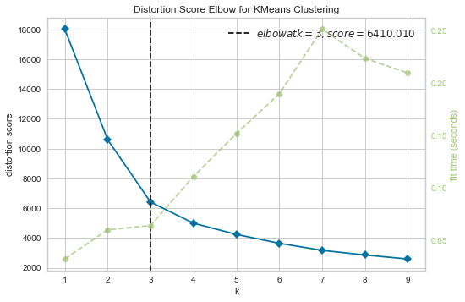
Analysis Overview – RFM analysis / K-means clustering
Used cross-validated KMeans clustering approach to identify customer segments.
yellowbrick’s KMeansVisualizer shows K of 3 produces the optimal distortion score.
* Information on the RFM approach is included in the appendix

Slide 8
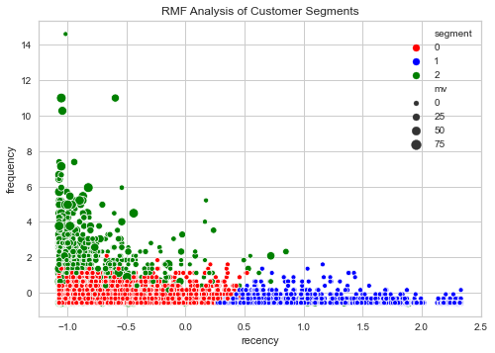
Analysis Overview – RFM analysis / K-means clustering
Segments represented by color, with (scaled) frequency and recency on the axes and size of the datapoint indicating monetary value.

Slide 9
Analysis Overview – RFM analysis / K-means clustering
Low frequency, low recency, low MV (LLL) customers - customers who have purchased recently, have a small number of overall purchases, and make relatively lower total purchases (red)
Low frequency, high recency, low MV (LHL) customers - customers who have not purchased recently with a small number of overall purchases, and a low total purchase volume (blue)
High frequency, high recency, high MV (HHH) customers - customers who purchase relatively often and recently, and have a high purchase volume (green)

Slide 10
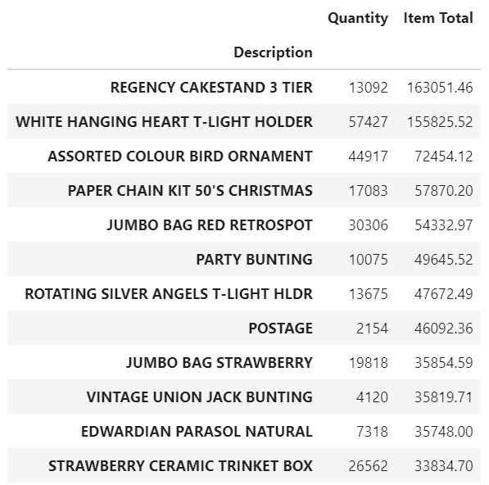
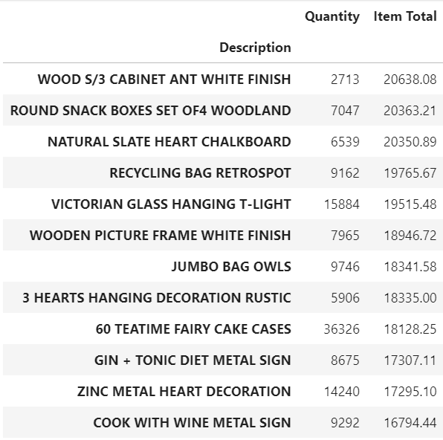
Analysis Overview – Product Sales
Top-grossing products
Top-grossing copurchases

Slide 11
Strategy Recommendations for Customer Segments
 | LLL | LHL | HHH
Description | Low frequency, low recency, low MV | Low frequency, high recency, low MV customers | High frequency, high recency, high MV customers
Total sales over time period | $5.87M | $2.72M | $.86M
Total customer # | 3,615 | 755 | 1957
Avg transactions/customer | 3.95 | 11.38 | 1.34
Median transaction value | $229.57 | $247.60 | $139.34
Strategy type | Upselling | Reacquisition | Retention

Slide 12
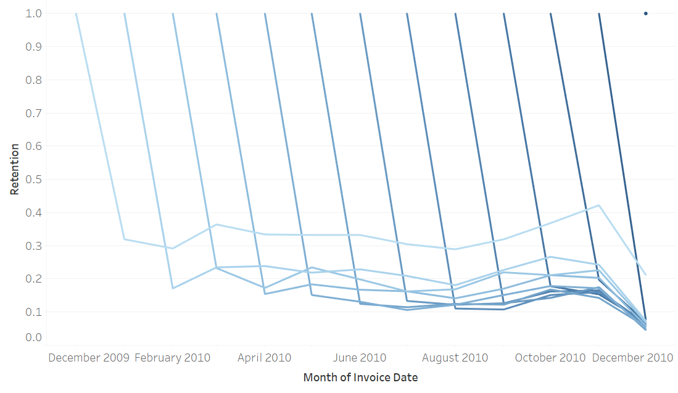
Analysis Overview – Customer Retention by Cohort Survival Curve
Newer customers demonstrate lower retention on average than older customers.

Slide 13
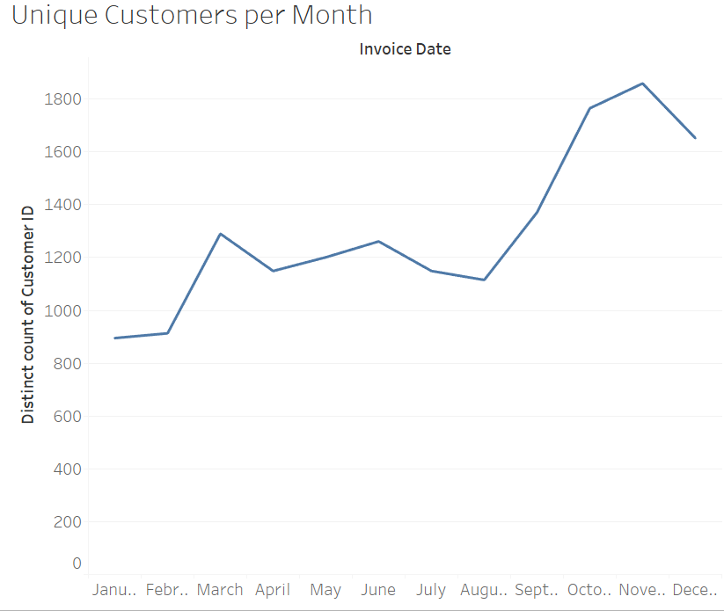
Analysis Overview – Unique Customers Over Time
Absolute number of customers has increased over the past ~4 months at a more rapid pace than we've seen before. Does increased customer base = lower touch/engagement = lower retention?

Slide 14
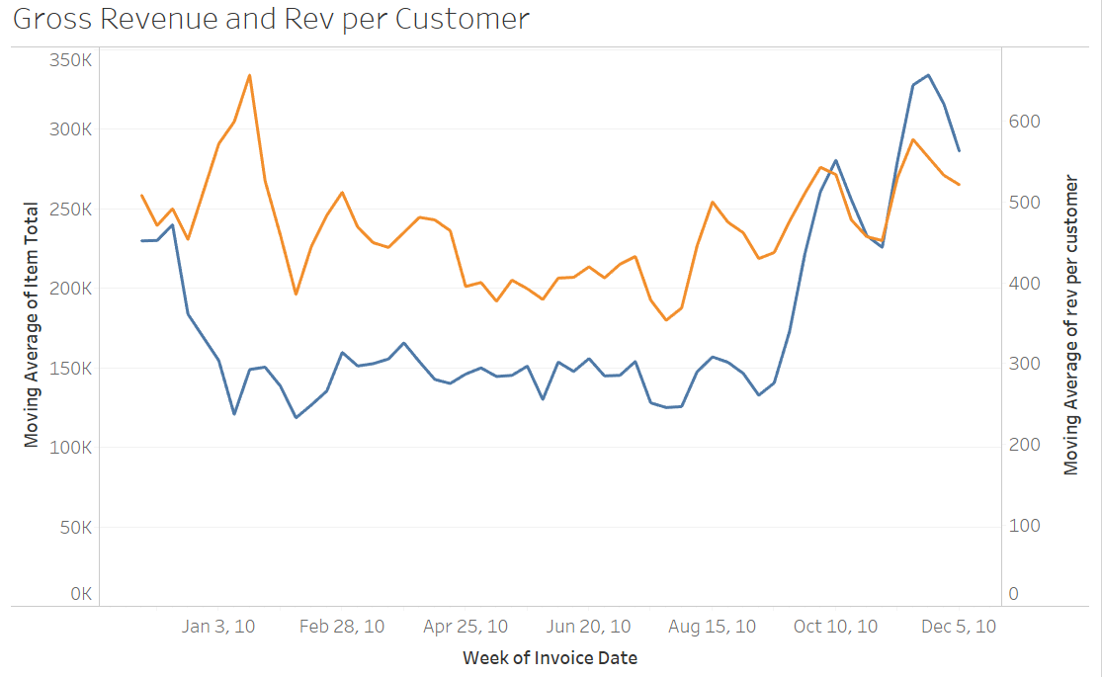
Analysis Overview – Gross Rev/Rev per Customer
Strong seasonality in sales - to be expected as the client is a seasonal gifts webstore. Revenue per customer goes up dramatically as well, indicating that customer acquisition strategies are working effectively.

Slide 15
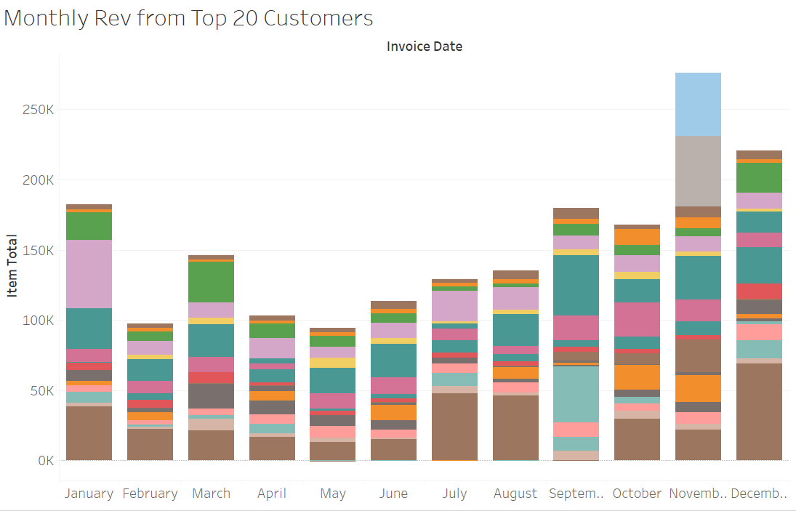
Analysis Overview – Top 20 Customers Monthly Rev
Similar trend in our top 20 customers - strong seasonality and dip in this group in December.
We increased both the number of customers and revenue per customer during the last month of the year, so we want to focus our engagement/upselling tactics with this top segment.

Slide 16
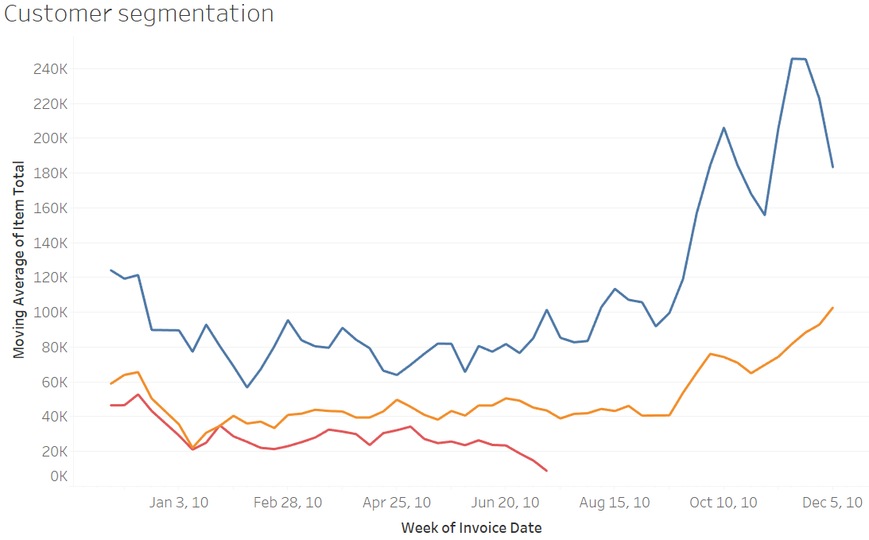
Analysis Overview – Rev by Customer Segment
The dip in December is still noticeable for our top revenue generating customer segment.

Slide 17
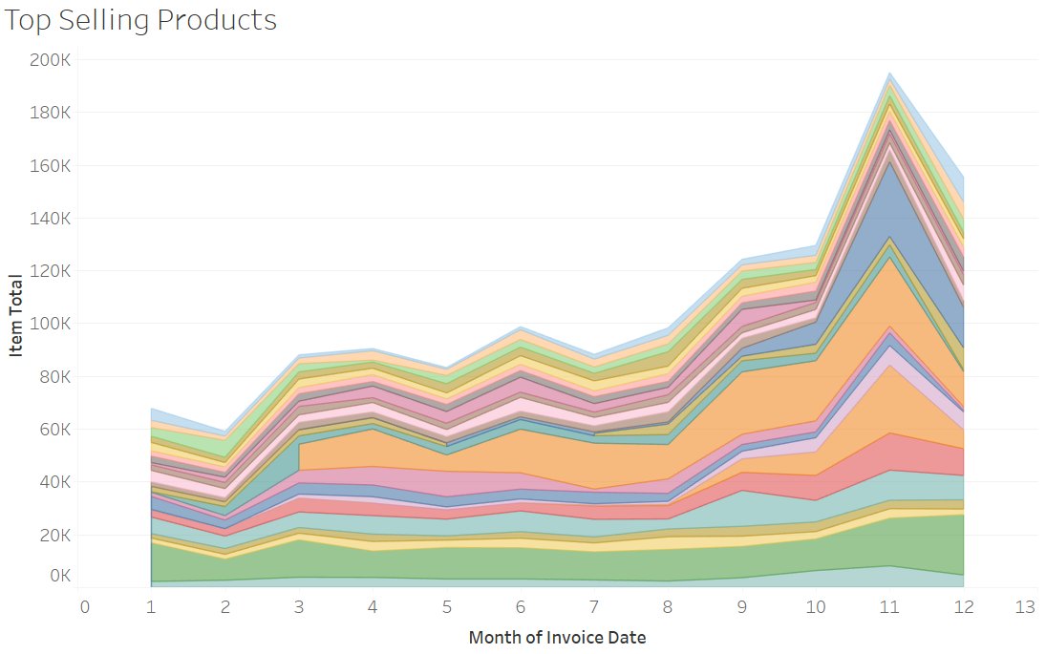
Analysis Overview – Seasonality of Product Sales
25 top selling products also see this dip. While sales of some increase over time, our largest sellers tend to vary revenue over time.
Developing a more refined understanding of what purchases may be correlated and the underlying factors playing into their seasonality could help us generate more revenue in the future.

Slide 18
Summary Recommendations
OnlineCo has the opportunity to better target customer acquisition and retention strategies based on newly-identified customer profiles.
OnlineCo has significant opportunities to improve sales and customer retention in light of seasonality identified in purchasing behavior
OnlineCo now has a framework to approach revenue generation by cross-promoting frequently copurchased products, focusing campaigns during peak potential purchase times, and driving customer retention of larger numbers of newly-acquired customers to the same levels as previously seen
Additional analysis focused on online customer behavior and marketing campaigns could better identify trends and learnings in OnlineCo’s business

